Slide 1
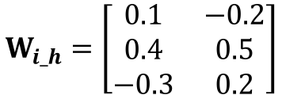







Forward Pass
$$W_{i_h}=\left[\begin{matrix}0.1 & −0.2 \\ 0.4 & 0.5 \\ −0.3 & 0.2\end{matrix}\right]$$
$$W_{h_o}=\left[\begin{matrix}0.3 \\ −0.1\end{matrix}\right]$$
Learning Rate $η=0.5$
0.5
0.1
$$X=\left[\begin{matrix}0.5 & −0.2 & 0.1\end{matrix}\right]$$
h1
-0.2
$$h_{in}=X∗W_{i_h}$$
0.3
-0.2
0.4
0.4
$$h_{out}=sigmoid\left(h_{in}\right)$$
0.5
$$o_{in}=h_{out}∗W_{h_o}$$
h2
-0.1
$$o_{out}=sigmoid\left(o_{in}\right)$$
-0.3
0.1
0.2
h1 = 0.1*0.5 + 0.4*-0.2 + -0.3*0.1 = -0.06 -> 0.4850
h2 = -0.2*0.5 + 0.5*-0.2 + 0.2*0.1 = -0.18 -> 0.4551
o1 = 0.4850 * 0.3 + 0.4551 * -0.1 = 0.1 -> 0.5250

Slide 2




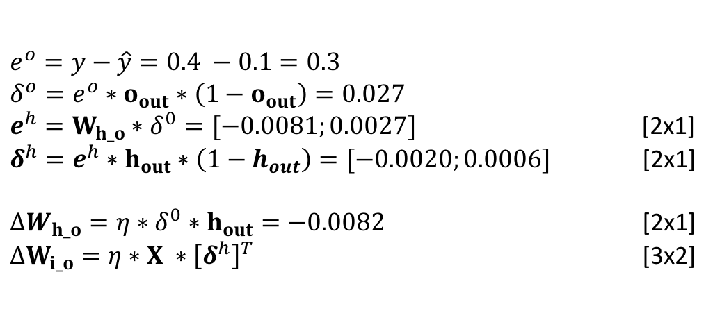
Backward Pass
$$W_{i_h}=\left[\begin{matrix}0.1 & −0.2 \\ 0.4 & 0.5 \\ −0.3 & 0.2\end{matrix}\right]$$
$$W_{h_o}=\left[\begin{matrix}0.3 \\ −0.1\end{matrix}\right]$$
Learning Rate $η=0.5$
0.5
0.1
$$X=\left[\begin{matrix}0.5 & −0.2 & 0.1\end{matrix}\right]$$
h1
-0.2
$h_{in}=X∗W_{i_h}$ [1x2]
0.3
-0.2
0.4
0.4
$h_{out}=sigmoid\left(h_{in}\right)$ [1x2]
0.5
$o_{in}=h_{out}∗W_{h_o}$ [1x1]
h2
-0.1
$o_{out}=o_{in}$ [1x1]
-0.3
$$e^{o}=y−\hat{y}=0.4 −0.1=0.3$$
$$δ^{o}=e^{o}∗o_{out}∗\left(1−o_{out}\right)=0.027$$
$e^{h}=W_{h_o}∗δ^{0}=[−0.0081;0.0027]$ [2x1]
$δ^{h}=e^{h}∗h_{out}∗\left(1−h_{out}\right)=[−0.0020;0.0006]$ [2x1]
$ΔW_{h_o}=η∗δ^{0}∗h_{out}=−0.0082$ [2x1]
$ΔW_{i_o}=η∗X ∗{\left[δ^{h}\right]}^{T}$ [3x2]
0.1
0.2
h1 = 0.1*0.5 + 0.4*-0.2 + -0.3*0.1 = -0.06 -> 0.4850
h2 = -0.2*0.5 + 0.5*-0.2 + 0.2*0.1 = -0.18 -> 0.4551
o1 = 0.4850 * 0.3 + 0.4551 * -0.1 = 0.1 -> 0.1

